Slide 1


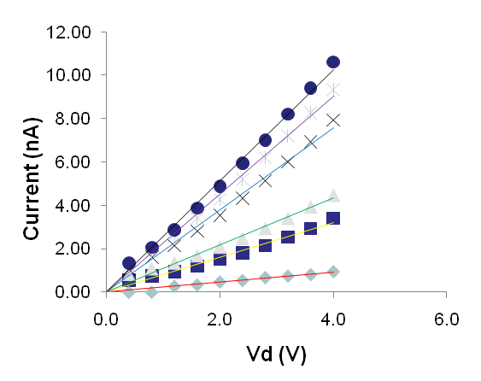
Project Title Here
Name and Supervisor here
Amino acids the building blocks of peptides and proteins and come in 21 varieties. There have been some initial studies using THz to probe amino acid structures and dynamics. However most of these studies use crystalline forms the amino acids crushed into a solid tablet form. This tablet in then probed with a range of THz frequencies from 0.1THz to 4THz. The experiments have been done for monomers and polymers for common amino acids.

